Slide 1

TRAINING
OF
General Elections to Lok Sabha, 2024
DCRC PERSONNEL
23.04.2024
Office of Chief Electoral Officer, West Bengal

Slide 2
DCRC Venue
Sister Nibedita Government General Degree College for Girls, West Bengal

Slide 3
Index
Sl | Subject | Slide
1. | Some new guidelines | 03 - 05
2. | Activities at Distribution Centre | 05 - 31
3. | Preparation of documents by Pr.O for RC | 32 - 55
4. | Activities at Receiving centre | 56 - 78
11. | Q&A | 79 - 80

Slide 4
New instructions
Presiding Officer's Report Format on Poll Day.
Part-I : Mock Poll Certificate
Part-II : Replacement of Power Pack of the Control Unit
Part-Ill : Pressing of Close Button after completion of Poll
Part-IV : EVM/VVPAT replacement Report, if replaced during Mock Poll
Part-V : EVM/VVPAT replacement Report, if replaced during Actual Poll
Collection of Presiding Officer's Report
(i) Part-I, Part-II and Part-III of the Presiding Officer's Report shall he kept in an envelope. Details to be printed on envelope:
  Name of election: (to be pre-printed)
  No. and Name of AC/AS: (to be pre-printed)
  No. and Name of PC: (to be pre-printed)
  Polling Station No: …………..
The Presiding Officer shall deposit the said envelope along with EVM, VVPAT and other election material at Collection Centre.
(ii) Part-IV and Part-V of the Presiding Officer's Report shall be collected by the Sector Officer, whenever any replacement is done. Sector Officers shall submit the said Reports to the Returning Officer.
Alternative document: Unique Disability Identity Card (UDID), Ministry of Social Justice & Empowerment, Govt of India

Slide 5
Use of Strip Seal is discontinued
Design of Pink paper seal for BU is changed.
Design of Green Paper seal is changed.
Use of plastic box for mock poll slips is discontinued. Only the blank envelops containing Mock poll slips have to be sealed with newly designed Pink Paper seal, no plastic box in this regard will be there.
Pr.O’s diary modified
Packeting system of election papers is changed.
PB only at facilitation centre, will not be sent through post office.
EDC procedure remains same.

Slide 6
New packet arrangement for RC
Packet | Colour | Name of packet | Item no | Content
1st | White | EVM Papers | 3 | 17C, Pr.O report I,II,III and envelop with Mock poll slip
2nd | White | SCRUTINY COVER | 4 | Pr.O diary, 17A, 14A, Visit sheet
3rd | White | STATUTORY COVERS | 5 | Marked copy, Voter’s slip, used tender ballot &17B, unused tender ballot, Form 14
4th | Yellow | NON-STATUTORY COVERS | 11 | Working copy, Form 10, EDC, Pr.O declaration, receipt book & cash, unused and damaged paper seals and special tags, unused voter’s slip, under age declaration & list, 49MA, ASD declaration, letter to SHO
5th | Brown | HANDBOOK/ MANUAL etc. | 3+ | Handbook, instructions- checklist, do’s & don’ts etc, Indelible ink, stamp pad
6th | Blue | OTHER MATERIALS | 5+ | Candidate information booklet, unused forms, Metal seal, Arrow cross mark, Cup of indelible ink
All remaining stationery items should be placed back in the respective transparent Cardboard/Carton containers and submitted at the Receipt Center.

Slide 7
Activities at Distribution Centre

Slide 8
Tagging of Polling Party at Distribution Centre
The Polling Personnel will come to know their respective Polling Station to which they are assigned only at the Dispersal Centre on P-1 day and not before it (For P-2 PS, it will be P-3 day).
Attendance through entry in wbemms portal. QR code scanning attendance also may be adopted.
Large display boards - Decoded list of polling personnel assigning polling stations to be displayed very prominently at multiple places
Single window counters – Reporting, issuance of order tagging polling station, distribution all materials including EVMs should preferably be done from one single counter to avoid inconvenience of polling personnel from shuttling between counters.
Reserved personnel - are to report at enquiry/PP counter and go to Reserve Shed.
Cash Counter for reserve tagging should be arranged, if required
Separate Counter for female PP may be thought of.
Token system may be followed for material receipt and depostion

Slide 9
Dispersal Centre to have following arrangements:
Enquiry counter
EDC distribution centre
Large display boards for decoded list of polling stations
SMS registration- facilitation centres
wbemms portal entry, QR code scanning facilities for attendance
Polling personnel Cell Counter
Token distribution
Polling station wise Single window counters
Counter for tagging for camera person/videographer for sensitive polling stations
Reporting and waiting area for Micro-observers
Waiting area for reserved polling personnel
Counter for training on demand
Counter for tagging vehicles
Counter for supplying (short) materials
Space for checking of EVMs & materials by polling parties.
xiii) Strong rooms for EVMs and storage of other material.
Medical Aid.
Fire brigade
Register for EVM, Pink Paper seal, Green paper seal, Address tag, Tender ballot, Speacial tag

Slide 10
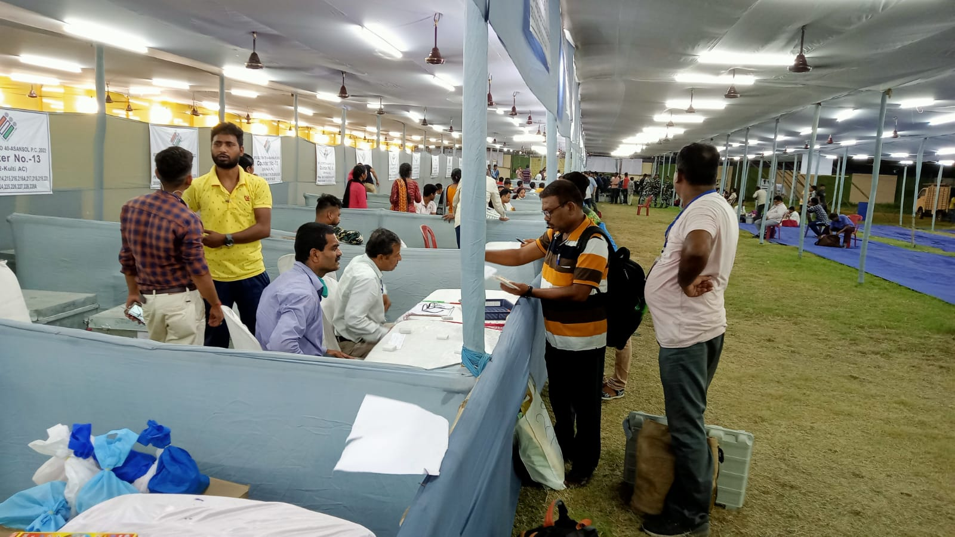

Slide 11
Activities at DC :
Identification of polling station tagged- From decoding list displayed
SMS registration- The PRO & PO1 will have to register their mobile number to the assigned phone number/wbemms portal entry/scanning of QR code
Collection of materials- Material to be collected and checked
Micro Observer/ Videographer- Contact with Micro Observer/ videographer, if deployed
Tagging of vehicle - Movement to the polling station to be made in earmarked vehicle
Tagging of force at police tagging counter
Movement to the polling station with sector force

Slide 12
Checking Polling Materials
EVM and VVPAT of your Polling Station
EDC/PB list
Indelible ink
One Marked copy and two Working Copy of E. Roll
Tendered Ballot Paper
Green Paper Seal, Special Tag, Strip Seal, Pink Paper Seal
Alphabetical Roll Locator
ASD and CSV list (if any)
Signature of candidate and Election Agent
Form 17A (Register of Voters), 17C, Pr.O diary, Declaration of Pr.O, Pro’s Report I,II,III, IV, V
Arrow Cross Mark, Metal Seal of Pr.O, Distinguishing Mark
Plastic box for Mock slips
‘MOCK POLL SLIP‘ rubber stamp
Other stationeries

Slide 13
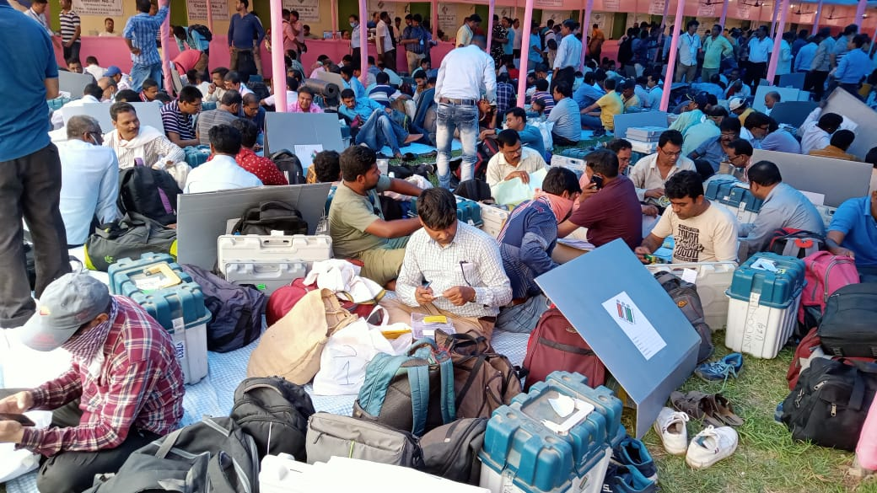

Slide 14
EVM/VVPAT checking
Check address tag of EVM/VVPAT and make sure whether it is assigned to your polling station
Candidate Set section of Cu is sealed
Ballot paper is properly fixed in BU
Thumb Wheel of BU is at 1 (If no of candidate including NOTA is less than equal to 16)
Unmasked Number of button of BU = number of candidate + NOTA. Other button of BU will be masked.

Slide 15
BU is sealed properly
Check with list (EVM/VVPAT, indelible ink, Marked copy, Tendered ballot, Green Paper Seal, Special Tag, Pink Paper Seal.
No need to check VVPAT at DC. No need to switch on before MOCK POLL.
Dont keep EVM/VVPAT in unassigned vehicle or unassigned place
Never keep EVM/VVPAT unattended without security

Slide 16
Electoral Roll
The Electoral Roll will be Integrated. Names included in SSR-2023 will not be bundled with their family members. New serialization in the Electoral Roll will not be made.
All additions made during continuous updation from the last date of final publication (22.01.2024) till the last date of nomination will be kept in order by issuing serial from the last serial of the roll onwards.
The published list will be marked Deletion/Correction
# means corrected in SSR-24
(2)# means corrected in Continuous updation.

Slide 17
DELETED across the board means that it has been removed in the SSR.
DELETED 2 across the board means that it has been removed in the Continuous Updation.
Beside each Deletion S / Q / R / M will be mentioned as the reason (E = Expired, S = Shifted, R = Repeated, Q = Disqualified, M = Missing).
Check the list of CSV, AIS, ASD and ARL.
Voters who have been given Election Duty Certificate and Postal Ballot will have the word ED and PB written next to their name respectively and the signature of the ARO next to it.

Slide 18
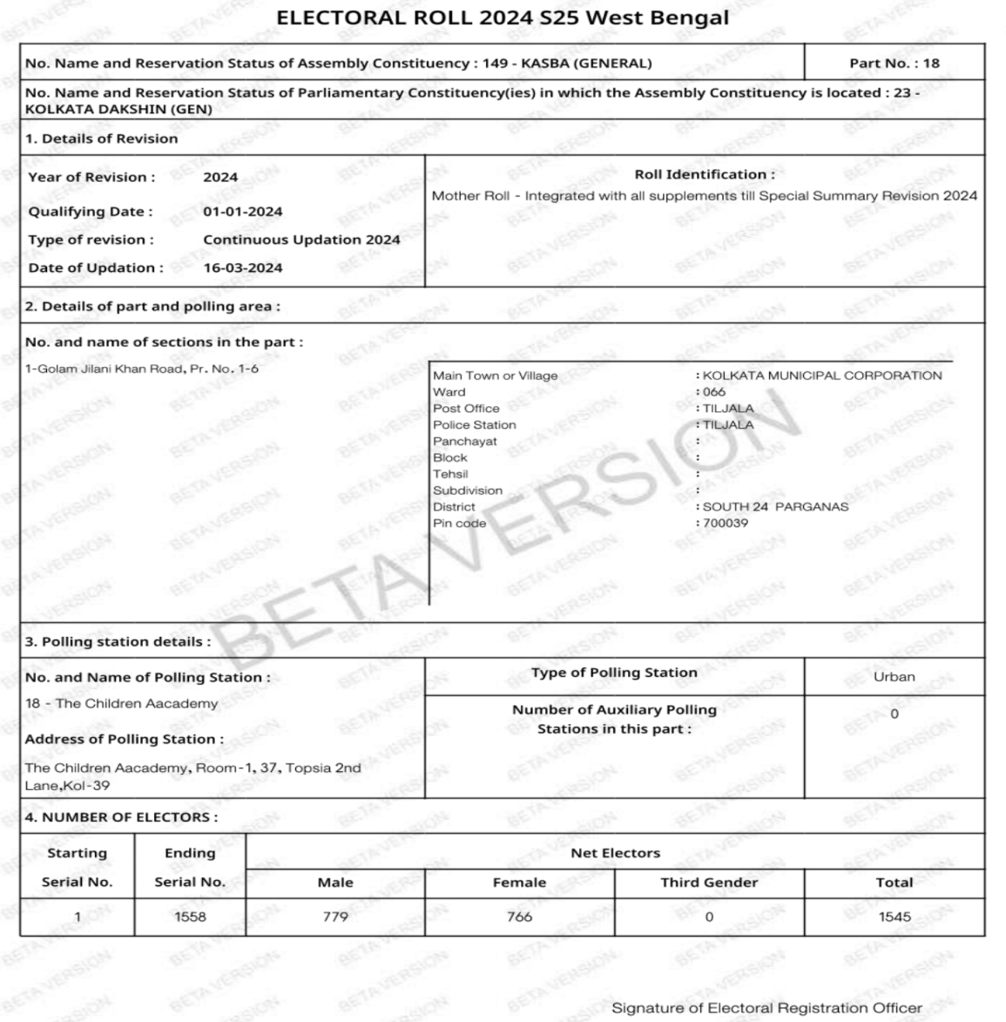
MARKED COPY OF ELECTORAL ROLL PG.

Slide 19
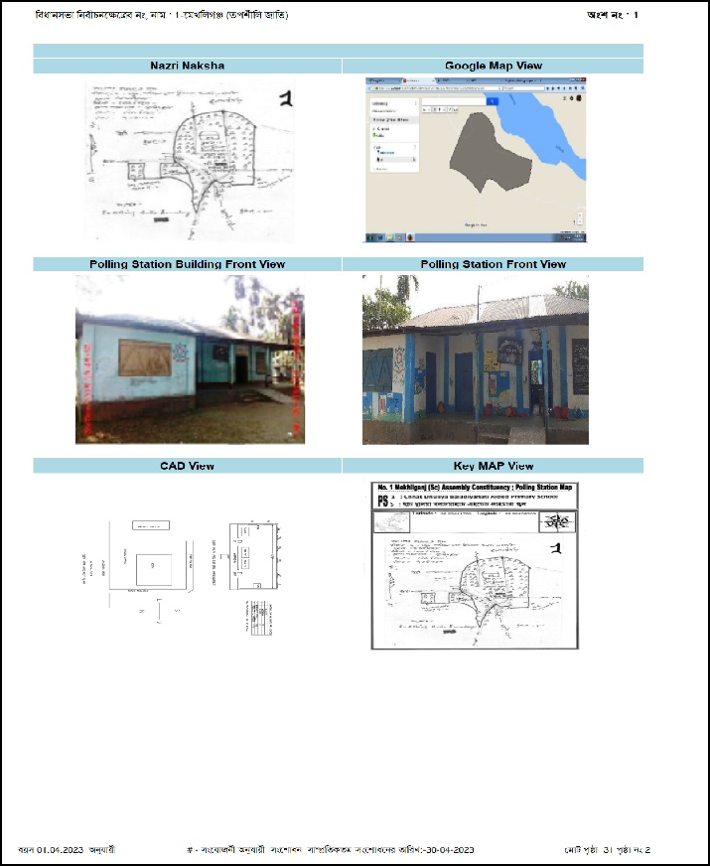

Slide 20
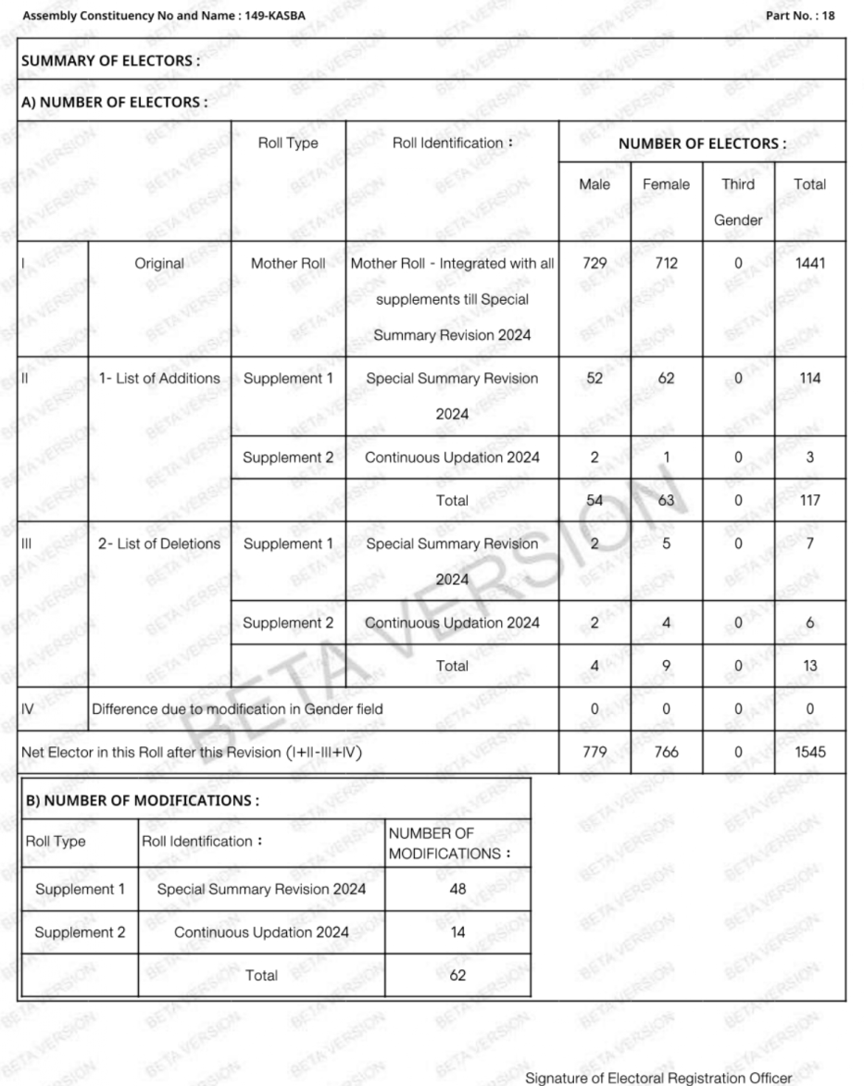
MARKED COPY OF ELECTORAL ROLL

Slide 21
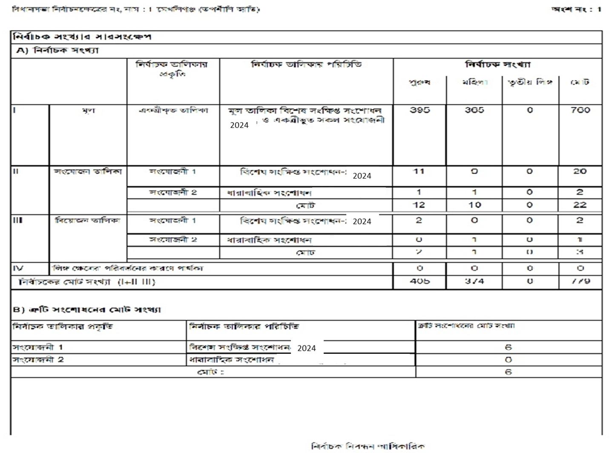

Slide 22
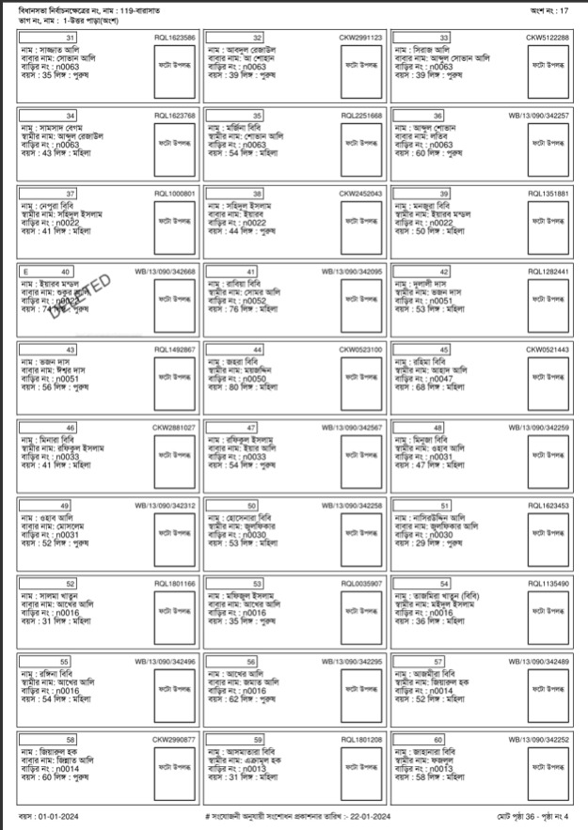
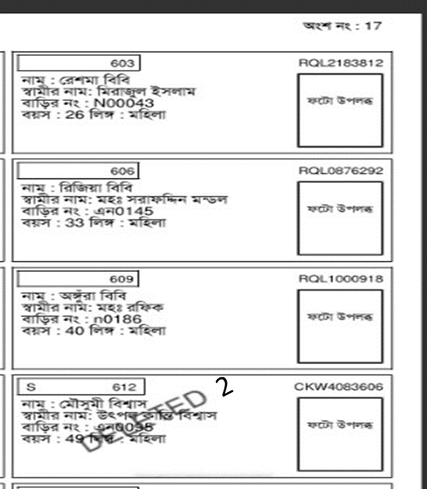
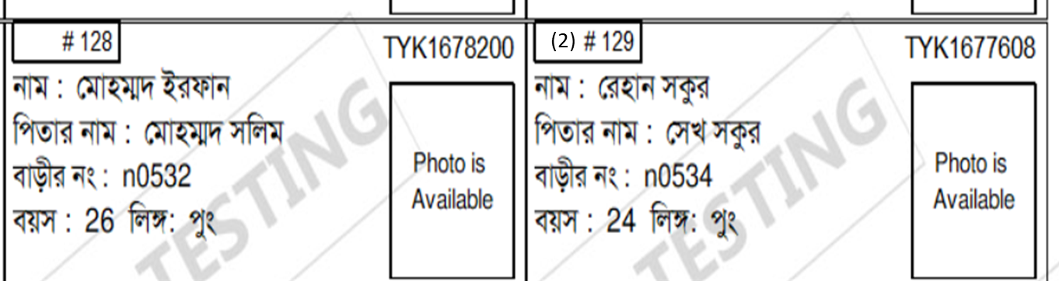
E-Roll for Poll
DELETED- Deletion in SSR
DELETED-2 : Deletion in Continuous updation
# - correction in SSR
(2)# -correction in Continuous updation

Slide 23
Voters who have the word PB next to their name cannot cast their vote at their booth.
EDC voters can vote at any booth of that PC (For Assembly election- AC) except the booth where they have their name.
Check the marked copy to see if all parts are correct
In case of Auxiliary booth, match the top sheet, total elector details and serial no
Match the PB/ED List given to you with the number of PB/EDC marked in the marked copy
Check whether each entry in the marked copy is authenticated
A control room with prominent signage to be set up for signing PB/ED mark if found missing during checking by PP at DC.

Slide 24
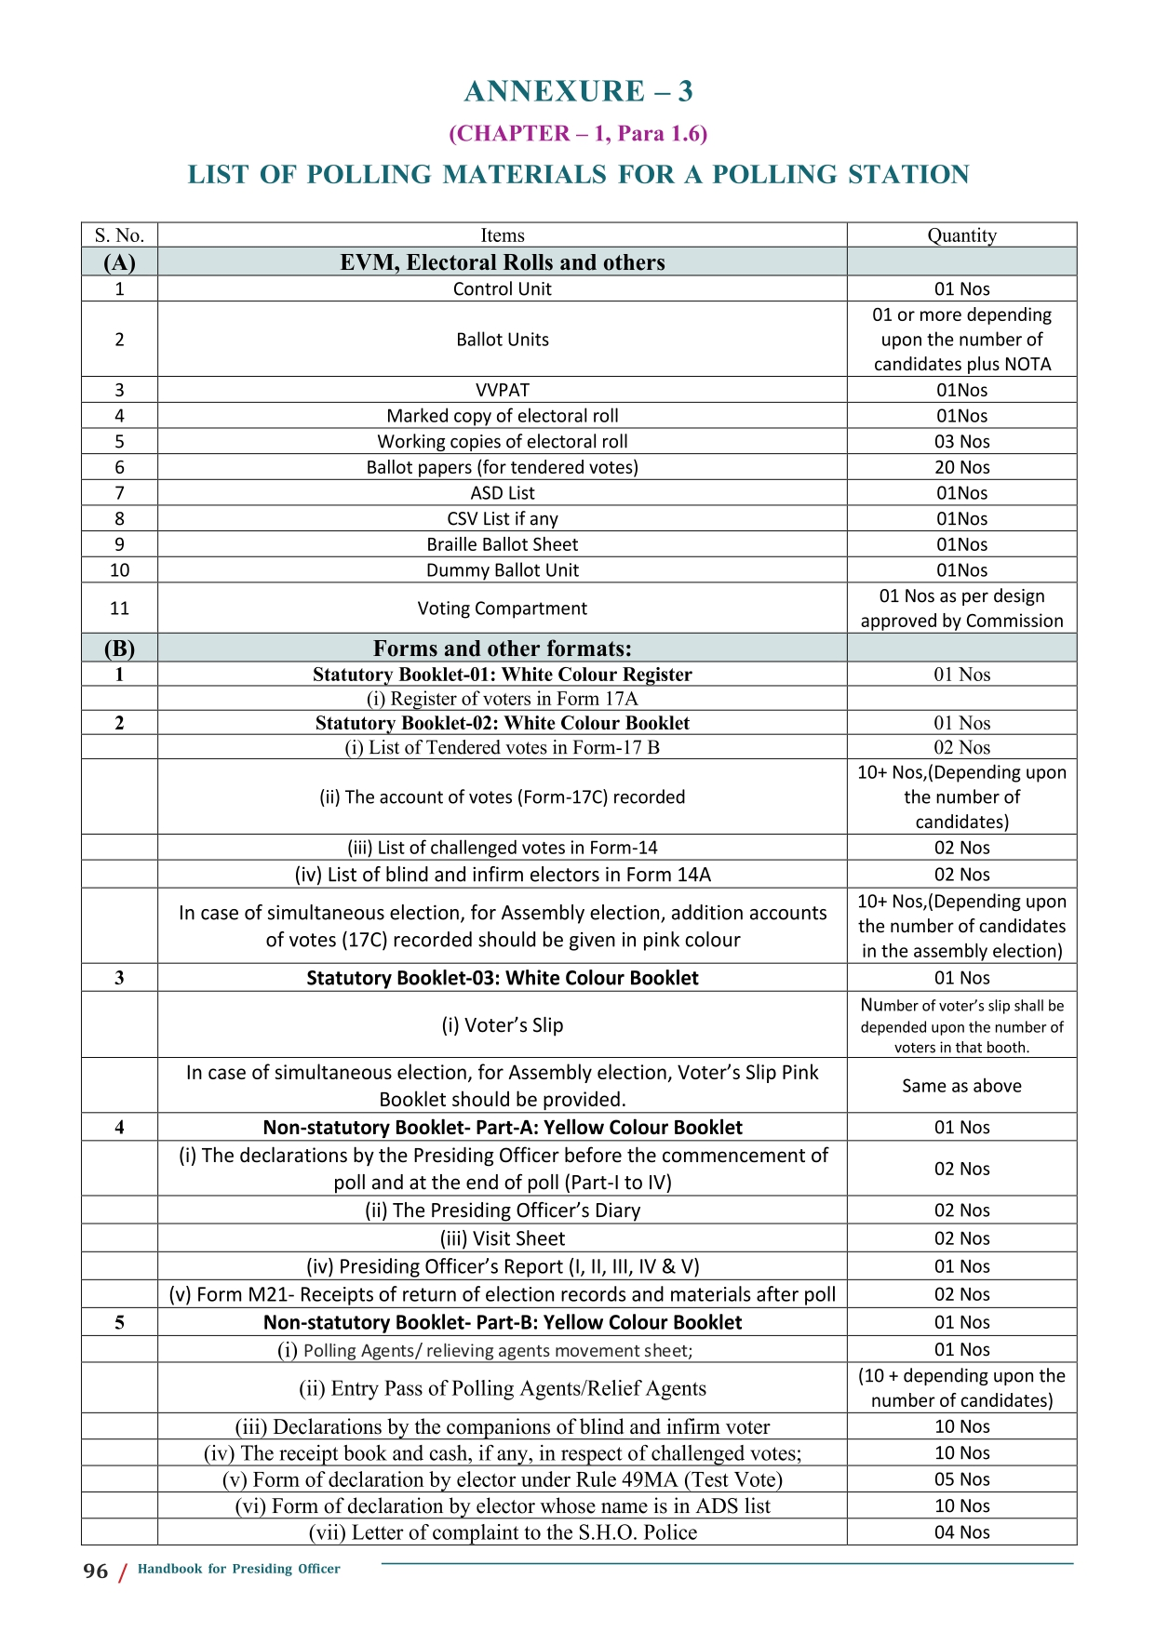
Polling Materials
EVM, E Roll, & others
B. Forms and other formats
C.Envelopes
D.Seals, tags & marks
E.Handbooks and instructions
F. Stationery items

Slide 26
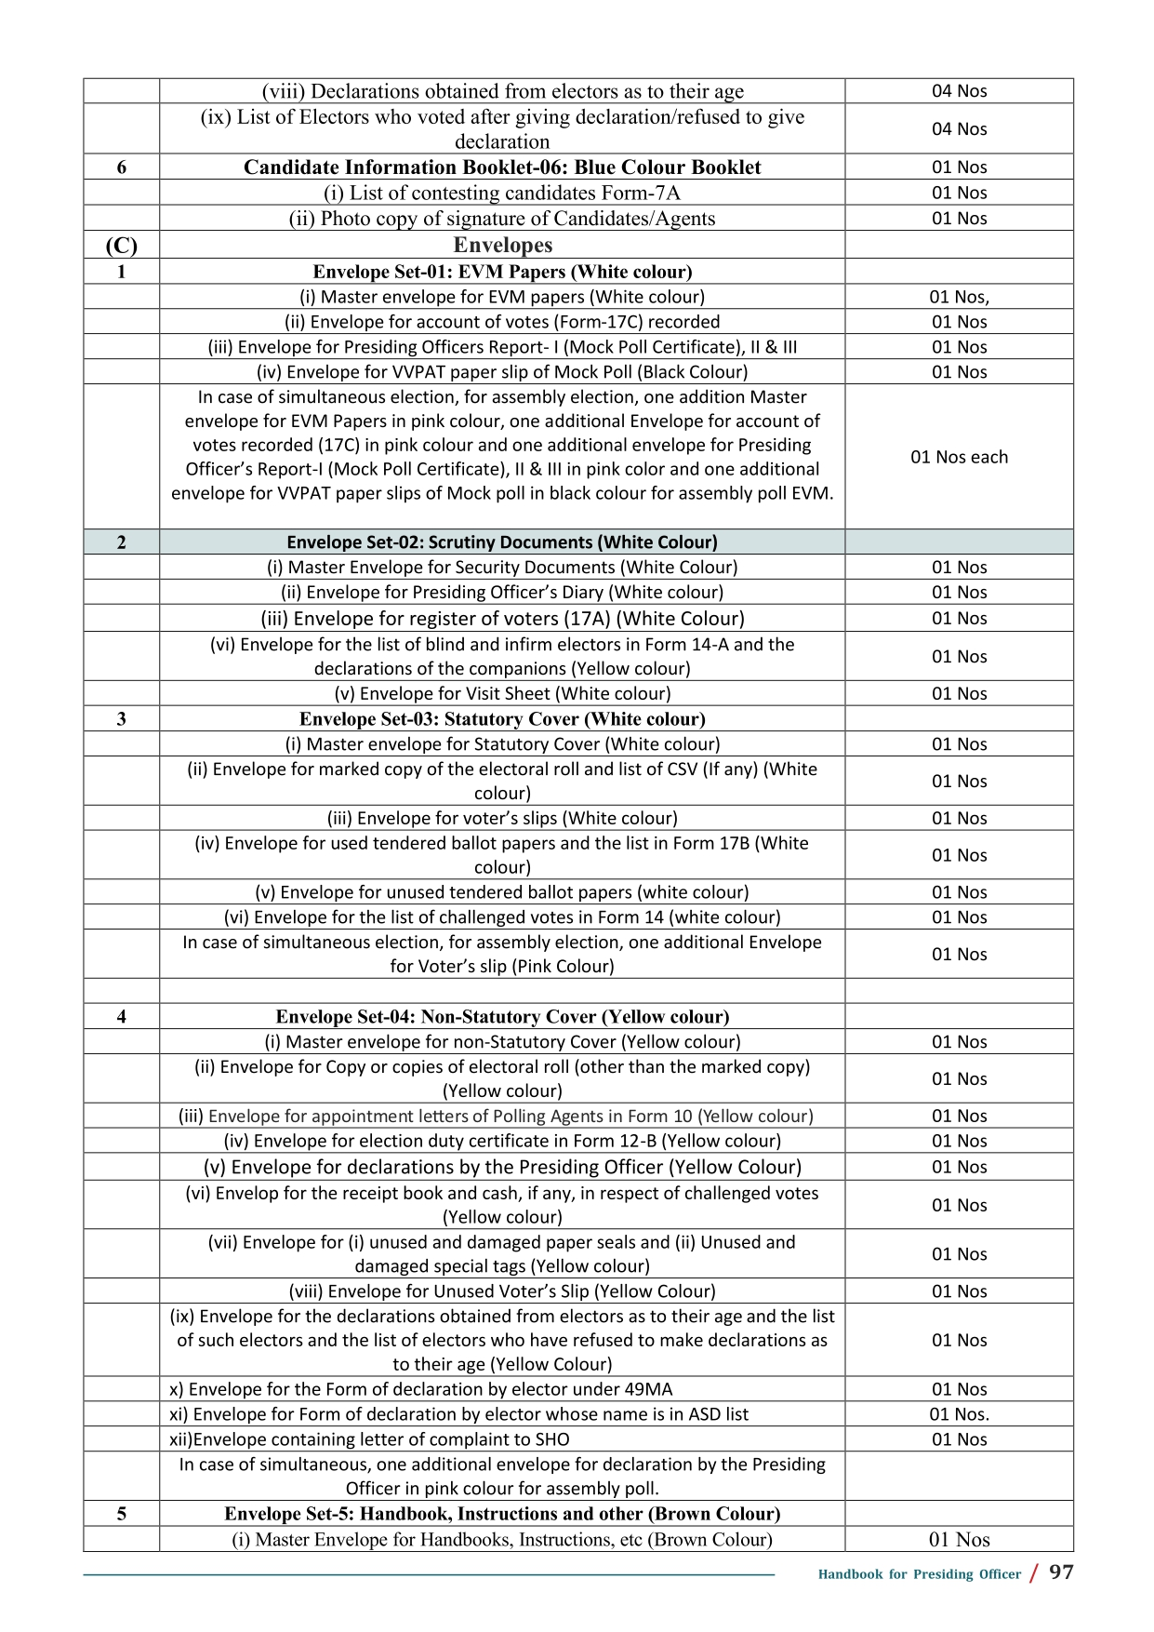

Slide 28
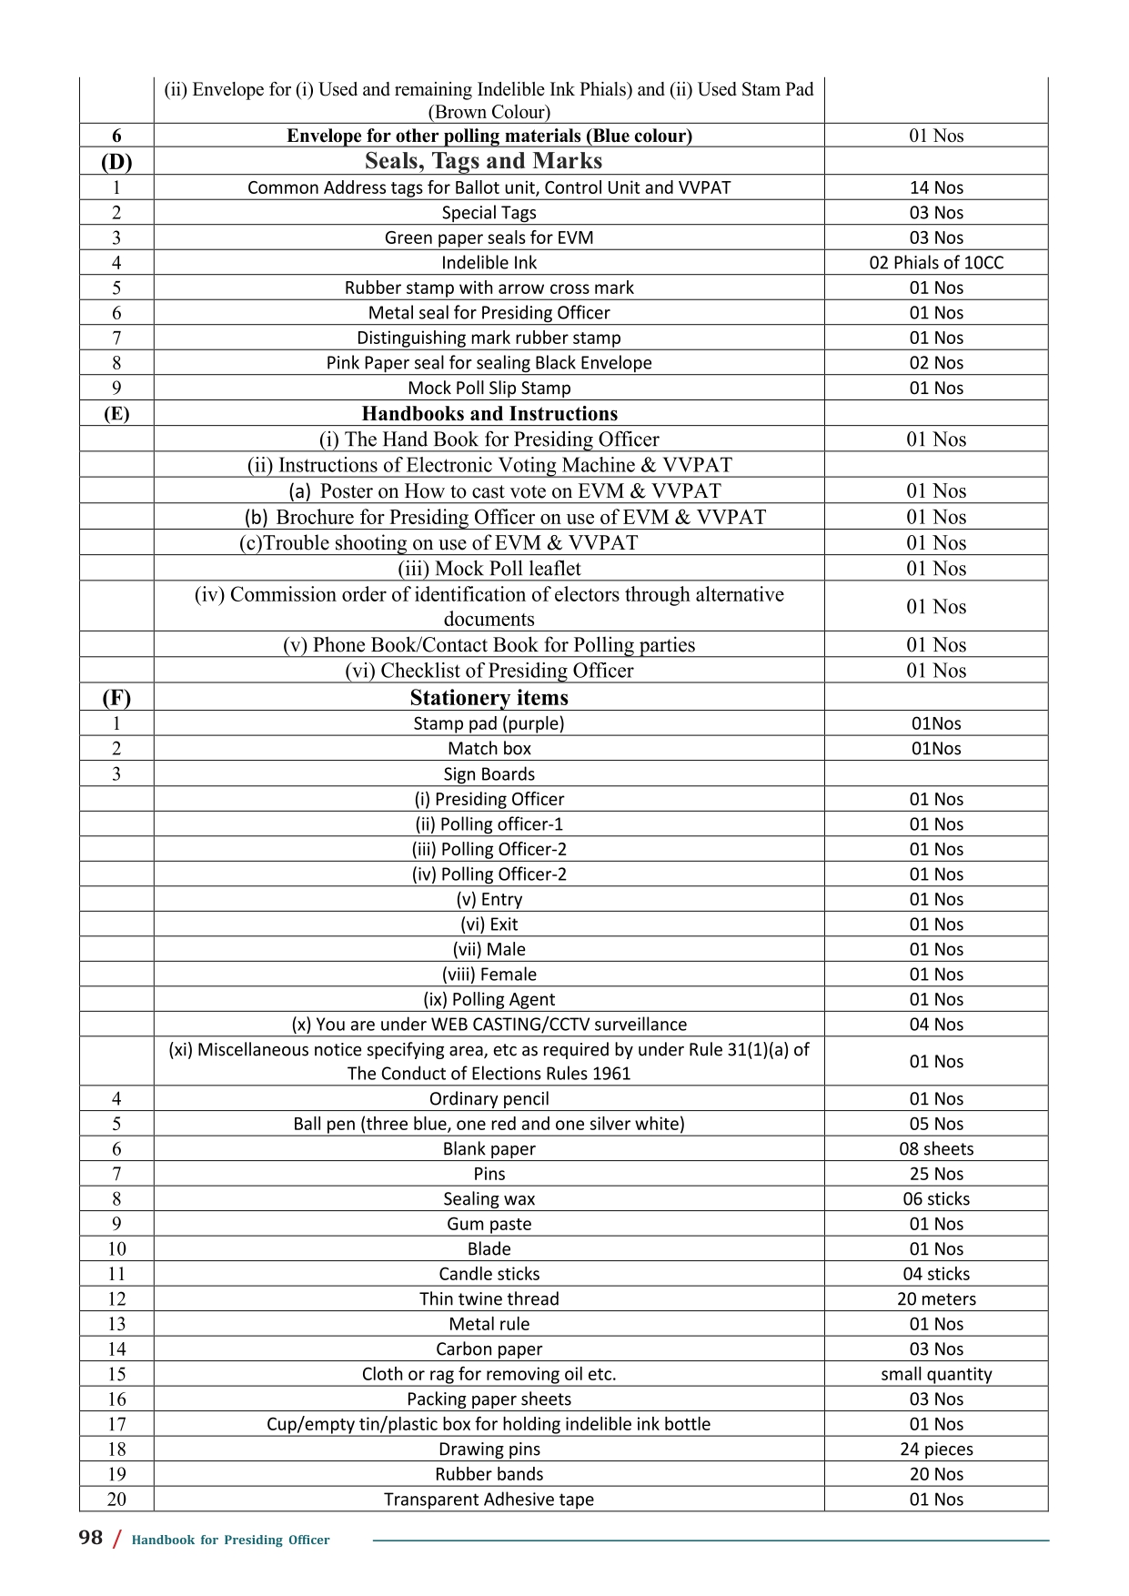

Slide 31
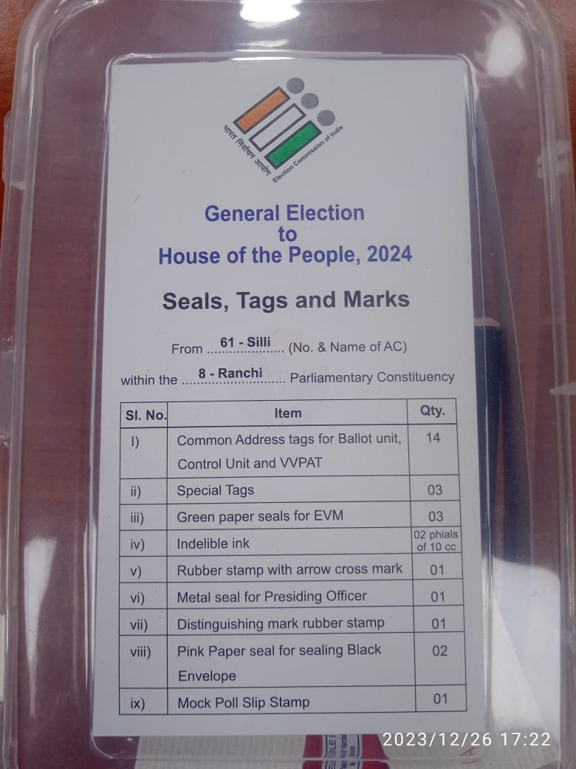
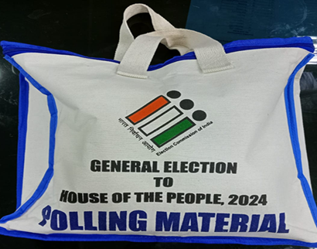
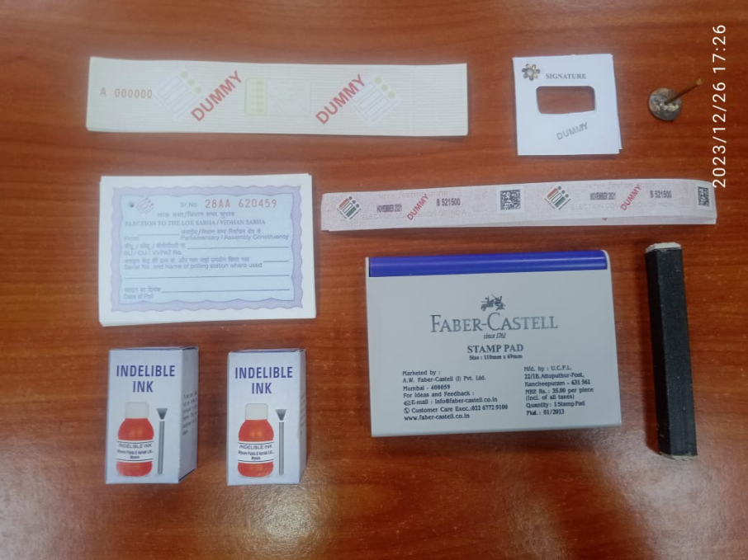

Slide 32
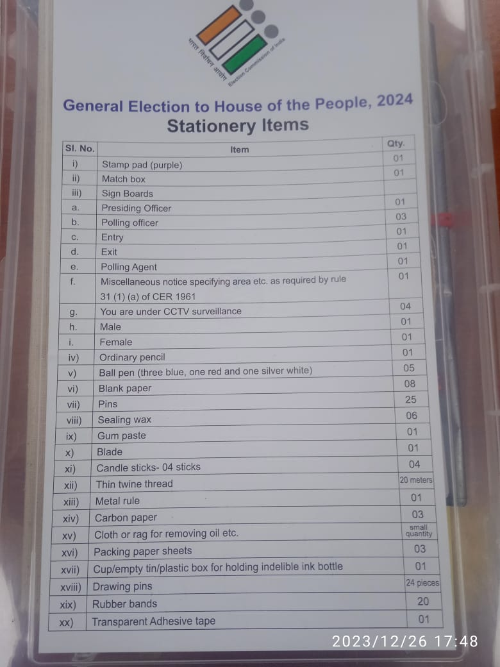
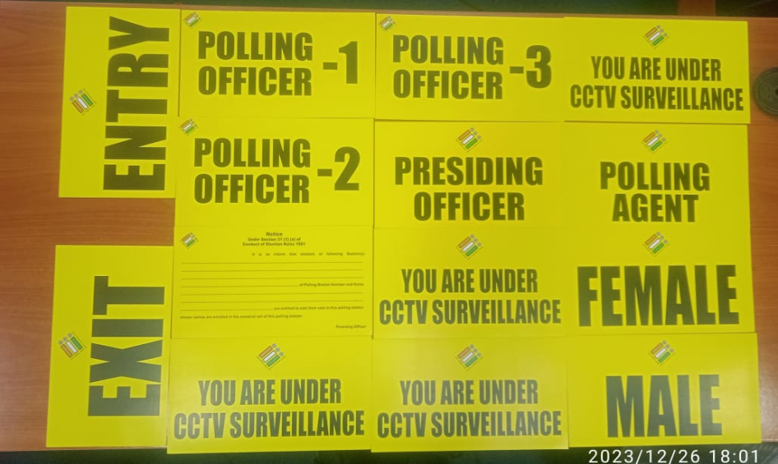
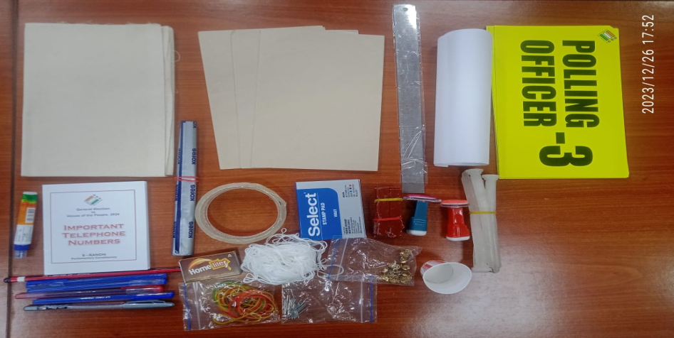

Slide 33
Prperation for RC by Polling team

Slide 34
Close Of Poll
Press CLOSE button of CU in presence of polling agents and replace the cap over it . Total no of votes recorded in the machine should be noted in item 5 of part-I of form 17C ;
Switch off the power and disconnect the BU from CU;
51/8/7/2019 -EMS dtd 09.04.2019 - After completion of poll, the Presiding officer shall remove the power pack (battery) from VVPAT in the presence of polling agents. Only after removal of power pack (battery) form VVPAT. The carrying case of VVPAT shall be sealed in the presence of Polling agents.
Draw a line after last entry in Form 17A and certify “The serial number of last entry in Form 17A is ……….” & sign. Obtain signature of polling agents present. Mention time of poll closure.

Slide 35
The precise time of close of poll should be indicated in PrO’s diary (COL 20b) and 17A.
The precise time of closure of poll should be included in PrO’s declaration and it should be same as shown in CU.
Account of pink paper seal- no specific col yet given. Pls write separately under Col 7 (Paper Seal account) of PrO Diary eg.
Similarly in the address tag, also time of closure of poll shall be mentioned there by PrO. Polling agents of candidates should be allowed to sign on address tags, if willing
7 i) Number of Paper seal used | Green- 1 | Pink- 1
ii) Sl No. of paper seal used | AA009758 | dsf98729

Slide 36
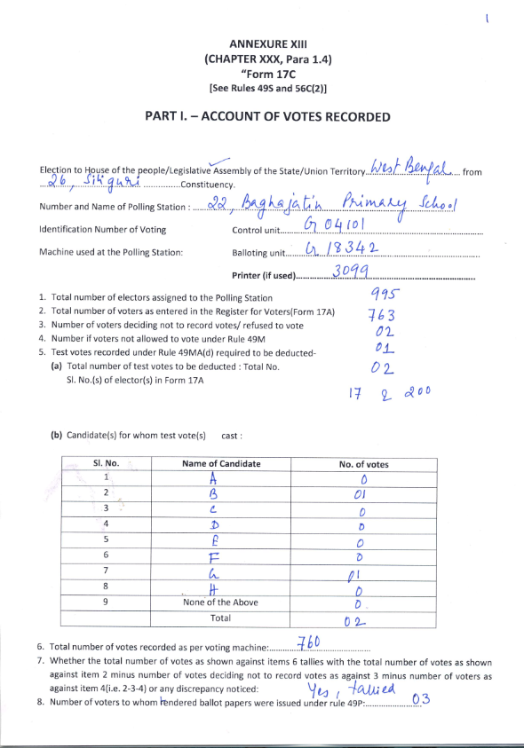

Slide 37
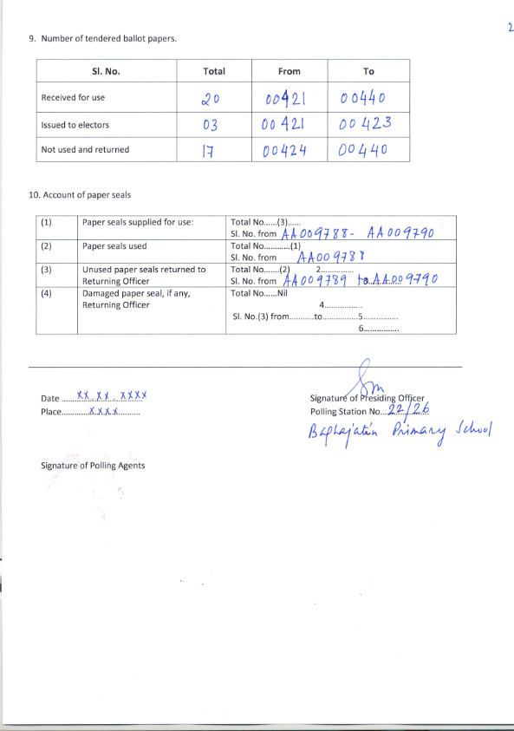

Slide 38
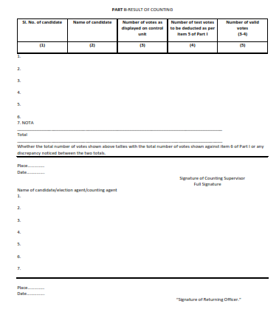

Slide 39
Items to be signed by polling agents on Poll day
Pr.O’s Report I, II, III and Mock Poll slips envelope. (before commencement of poll and on subsequent replacement of EVM if any)
Green paper seal, Pink paper Seal, Spl. Tag- At the time of sealing CU after mock poll
Presiding Officer’s Declaration
  Part-I: before commencement of poll
  Part-II: on subsequent replacement of EVM if any
  Part-III: At end of poll
  Part-IV: After sealing of EVM
17A- after close of poll, below PrO’s signature
17C Part-I (after poll)
Movement sheet as and when applicable

Slide 42
Signature…………
Presiding Officer
Date…..

Slide 44
Affixing of Seal thereon by the Polling Agents:
The Polling Agents present at the polling station are also permitted to affix their seals, in addition to the seal of the Presiding Officer, on the envelopes and packets containing the following documents:
(a) The marked copy of the electoral roll;
(b) Register of Voters;
(c) Voters slips;
(d) The tendered ballot papers and the list of tendered voters in Form 17B;
(e) The unused tendered ballot papers;
(f) The list of challenged votes;
(g) The unused and damaged paper seals, if any;
(h) Appointment letters of Polling Agents; and
(i) Any other papers that the Returning Officer has directed to be kept in a sealed packet.

Slide 45
SEALING OF EVM and Polled Materials AFTER POLL
Switch off the CU & put in Carrying case and seal it at both ends with addressed tag with the help of seal of Presiding Officer;
Agents present should be asked to affix their seals;
Names of candidates/ polling agents who have affixed their seals on carrying cases of CU should be noted in the declaration at the close of poll;

Slide 46
PREPARATION OF PRO’S DIARY
Record relevant events as and when they occur at regular intervals;
Any lapse of writing diary at regular intervals is seriously viewed by ECI;
One of the important documents verified by the OBSERVER on the day after poll at the time of scrutiny;

Slide 47
Visit Sheet
Patrolling Magistrate, Sector Officer, Zonal Magistrate, DEO, RO, AROs and Election Observers, whenever they visit any polling station, shall make an entry in the VISIT SHEET kept with the Presiding Officers. Visit Sheet shall be deposited after end of poll along with Presiding Officer's Diary.
One of the important documents that will be verified by the OBSERVER on the day after poll at the time of scrutiny

Slide 48
    SEALING OFELECTION PAPERS IN PACKETS
The large White cover superscribed as “EVM papers” comprising
the unsealed envelope containing Account of votes recorded (Form 17C),
Unsealed envelope containing the Presiding Oﬃcer Report-I (Mock poll certiﬁcate), II & III and
Sealed Black envelope containing printed VVPAT paper slips of Mock poll shall be placed along with polled EVMs in the polled EVM Strong Room.

Slide 49
Special Counter at RC
for receiving EVMs/VVPATs and other documents from the specific polling-stations about which complaints had been received from political parties / candidates during the course of polling;
polling stations in which significant event such as violent-incidents, heated arguments with the polling personnel, clash between polling -agents, break-down of machines reported and where the EVM replacement had taken place .
SECOND PACKET (WHITE) : SCRUTINY DOCUMENTS (To be kept in Strong room other than EVM Strong room)
 | Envelope Set-02: Scrutiny Documents (Second Packet) | 2/1 Master Envelope for Scrutiny Documents Size (16”X12”) | Envelope No. 2/2 for Presiding Officer’s Diary, Size (10”X4.5”) | 1
 |  |  | Envelope No. 2/3 for register of voters (17A), Size (14”X10”) | 1
 |  |  | Envelope No. 2/4 for the list of blind and infirm electors in Form 14-A and the declarations of the companions (10”X4.5”) | 1
 |  |  | Envelope No. 2/5 for Visit Sheet (10”X4.5”) | 1

Slide 50
Six separate large packets:
Even if a statement or record to be mentioned in the statutory form or non-statutory form is ‘Nil’, such ‘Nil ‘remark should be marked on the concerned statutory form or non-statutory form and placed in the respective envelopes and packed in the large packets.
First packet (WHITE) - “EVM PAPERS COVER”
a)Envelope containing the account of votes recorded (Form-17C),
b)Envelope containing the PrO Report I (Mock-Poll Certiﬁcate), II & III
c)Black color Sealed Envelope containing Printed VVPAT paper slips of Mock Poll
Note: All the above election papers should be kept in unsealed white coloured master envelope (Envelope No: 1/1) and should be kept in the Polled EVM Strongroom.
In case of simultaneous election-
for assembly election,
one additional Master envelope for EVM Papers in pink colour,
one additional envelope for account of votes recorded (17C) in pink colour and
one additional envelope for Presiding Oﬃcer’s Report-I (Mock Poll Certiﬁcate), II & III in pink color and
one additional envelope for VVPAT paper slips of Mock poll in black colour for assembly poll EVM.

Slide 51
Second packet (colored WHITE)
-unsealed/sealed envelopes ( “SCRUTINY COVER”)
a)Unsealed envelope containing the Presiding Oﬃcer’s Diary
b)Sealed envelope containing the register of voters (17A)
c)Unsealed envelope containing Visit Sheet
d)Unsealed envelope containing the list of blind and inﬁrm electors in Form 14-Aand the declarations of the companions.
Note: All the above election papers should be kept in unsealed white coloured master envelope (Envelope No: 2/1) and Polling Station wise scrutiny cover required for scrutiny should be stored separately in a strong room other than Polled EVM strongroom having polled EVMs and VVPATs.

Slide 52
Scrutiniy report to be collected from Pr.O and data entry of to be done at RC
A) | State / UT Code & Name: |  |  | S25- WEST BENGAL
B) | Parliamentary Constituency No. & Name :
C) | Assembly Segment No. & Name :
Polling Station No. & Name |  | Total Electors in the P.S. |  |  |  | Number of persons who voted in the P.S. |  |  |  | Number of Tendered votes | Number of Challenged votes | Number of Proxy votes by CSVs
No. | Name | Male | Female | TG | Total | Male | Female | TG | Total
Number of electors who excercised their right of vote on the basis of EPIC | Number of electors who excercised their right of vote on the basis of alternative document. | Number of voters who excercised their right under Rule 49 O, who decided not to record vote | Number of polling agents in the polling station | Number of overseas electors who voted in the poll | Number of BU, CU, VVPAT used | Whether the BU, CU or VVPAT was changed or replaced (Y/N) | If so, the time when changed and what was the reason for it | Total ASD voters in the ASD voters list | Total persons who cast their vote from ASD voters list | Any incident of violence or poll interruption due to any reason (Y/N) | Any complaints received with respect to polling station (Y/N)

Slide 53
Third Packet ( White Color) – Statutory Cover
Sealed envelope containing the marked copy of the Electoral Roll and list of CSVs
Sealed envelope containing voter’s slip
Sealed envelope containing unused tendered ballot papers
Sealed envelope containing the used tendered ballot papers and the list in form 17 B
e) Sealed envelope including challenged vote in form 14

Slide 54
Fourth Packet (Non-Statutory Cover ) - Yellow
a)Envelope containing the copy or copies of electoral roll (other than the marked copy)
b)Envelope containing the appointment letters of Polling Agents in Form 10
c)Envelope containing the election duty certiﬁcates in Form 12- B
d)Envelope containing declarations by Presiding Oﬃcer
e)Envelope containing receipt book and cash if any, in respect of challenged votes
f)Envelope containing the declarations obtained from electors as to their age and the list of such electors who have refused to make declaration as to their age
g)Envelope containing unused and damaged paper seals and special tags
h)Envelope containing unused voter’s slips
I)Envelope containing Form of Declaration by elector under 49MA (Test Vote)
j)Envelope containing Form of Declaration by elector whose name is in ASD list
k)Envelope containing letter of complaint to SHO

Slide 55
Fifth Packet (Brown)
a.Handbook for Presiding Oﬃcer,
Manual of Electronic Voting Machine and VVPAT,
instructions etc.
b.Used and remaining Indelible ink set
c.Used Stamp pad (Brown colour)

Slide 56
Sixth Packet (Blue colour)
a)Candidate Information Booklet
b)Other unused forms
c)Metal seal of the Presiding Oﬃcer
d)The arrow cross-mark rubber stamp for marking tendered ballot papers;
e)Cup for setting the indelible ink.
f)All the other items, if any, should be packed into the Fifth packet (colored Blue).

Slide 57
ACTIVITIES AT RECEIVING CENTRE

Slide 58
Management of receipt of voting materials
There will be provision for receiving voting materials by setting up counters for specific number of polling stations.
Various items will be received as per the checklist.
The staff who is receiving the items will take the items only after checking it carefully.
Whether polling materials of that same polling station be deposited at that counter or not?
BU/CU/VVPAT is sealed.
Match number of BU/CU/VVPAT as per EVM Receipt Register.
EVM Receipt Register must bears the signature of the Presiding Officer.
Votes mentioned in 17C matches with 17A.
Presiding Officer's diary is duly filled and VISIT SHEET is attached.
Polling agents are given 17C.
Mock Poll Ballot Slip Plastic Box Envelope I

Slide 59
Additional Format Report of the Presiding Officer has been submitted
Diary of the Presiding Officer - 1 copy, without seal.
Form 17C- 2 copies, one sealed and the other without seal.
Declaration or Annexure VII of the Presiding Officer - 1 copy, without seal.
VISIT SHEET- 1 copy, without seal
PS-05- 1 copy, without seal
17A
16 PT OBSERVER REPORT
Pr.O’s Report Part 1 & 3 must. 2, 4, 5 (If applicable)
LOG SHEET OF CAMERA
POLLING AGENT MOVEMENT SHEET
FORM 14A.
Scrutiny sheet
Plan safe departure of PP after deposition of materials at RC.

Slide 60
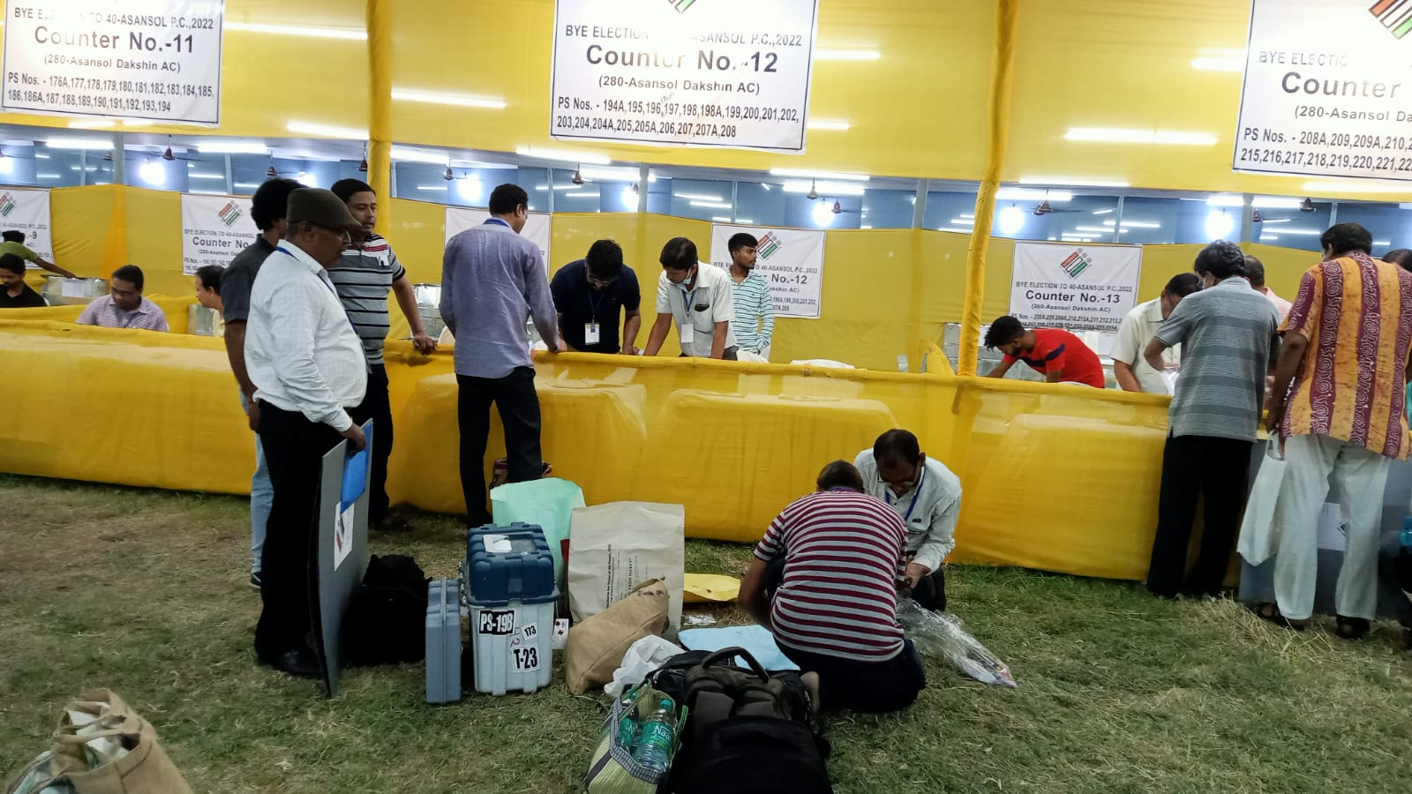

Slide 61
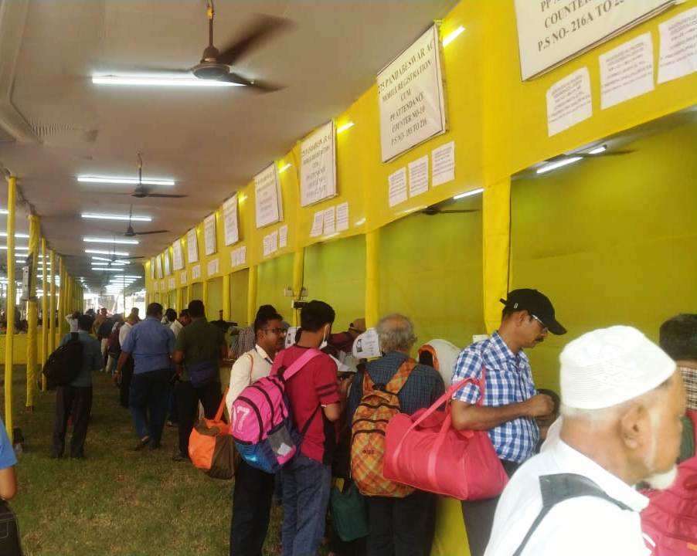

Slide 62
SPECIAL COUNTER AT RC
On top of these counters, the number and name of the specific Polling Station will be written.
There will be some special counters where -
Any complaints submitted
Any significant incidents such as SNATCHING or destruction of EVMs happened.
Replacement of EVM/VVPAT
For these booths, the RO will create a separate register and after verifying the documents including EVM/VVPAT, the RO will discuss it with the Observers. After that, the Presiding Officer will be given instructions.

Slide 63
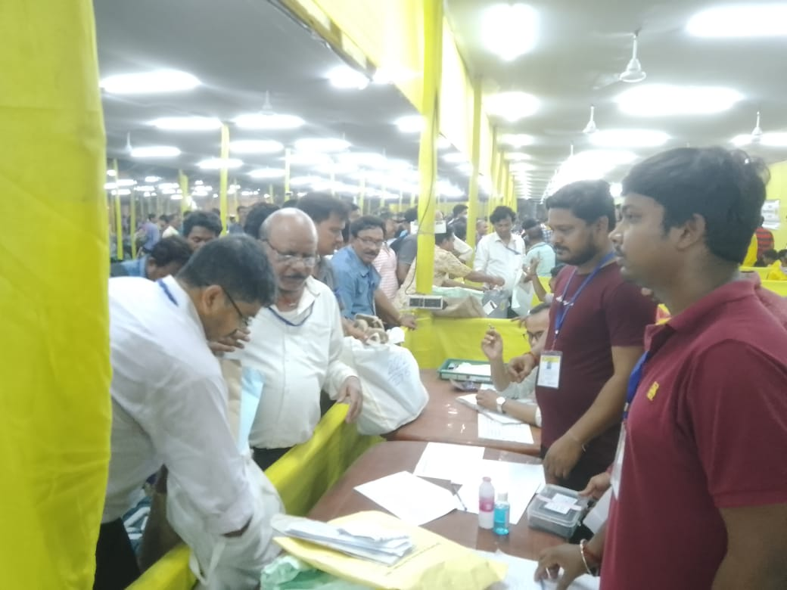

Slide 64
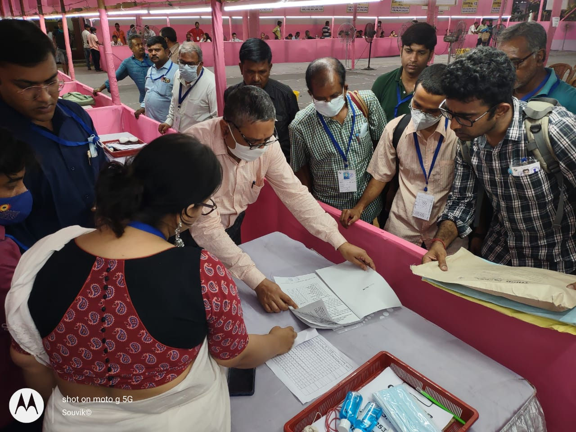

Slide 65
Receiving centre
17 C and one copy of Mock poll certificates and black envelope sealed in strong room attached to C.U of EVM.
Send BU, CU and VVPAT to strong room with transit slip register
The complete set of polled CU-BU-VVPATs of the polling station should be kept in the same strong room.

Slide 66
Management of submission of EVMs and VVPATs after polling
Type of machine | STORAGE | Force | Remarks
Category A and B will be accommodated in the strong room according to the polling station. In the squares of the strong room, the BU, CU, and VVPATs must be kept together. | Allowed In the strongroom | One Platoon CAPF | Sealed envelopes with mock poll slips will accompany A & B machines
Not around the strong room 1. Category C - Unpolled Defective (District Warehouse) 2. Category D - Reserved Unused Machines - Partitioned in the warehouse | At the District Warehouse | 1/2 section | Defective and unused machines must be collected at the same time.

Slide 67
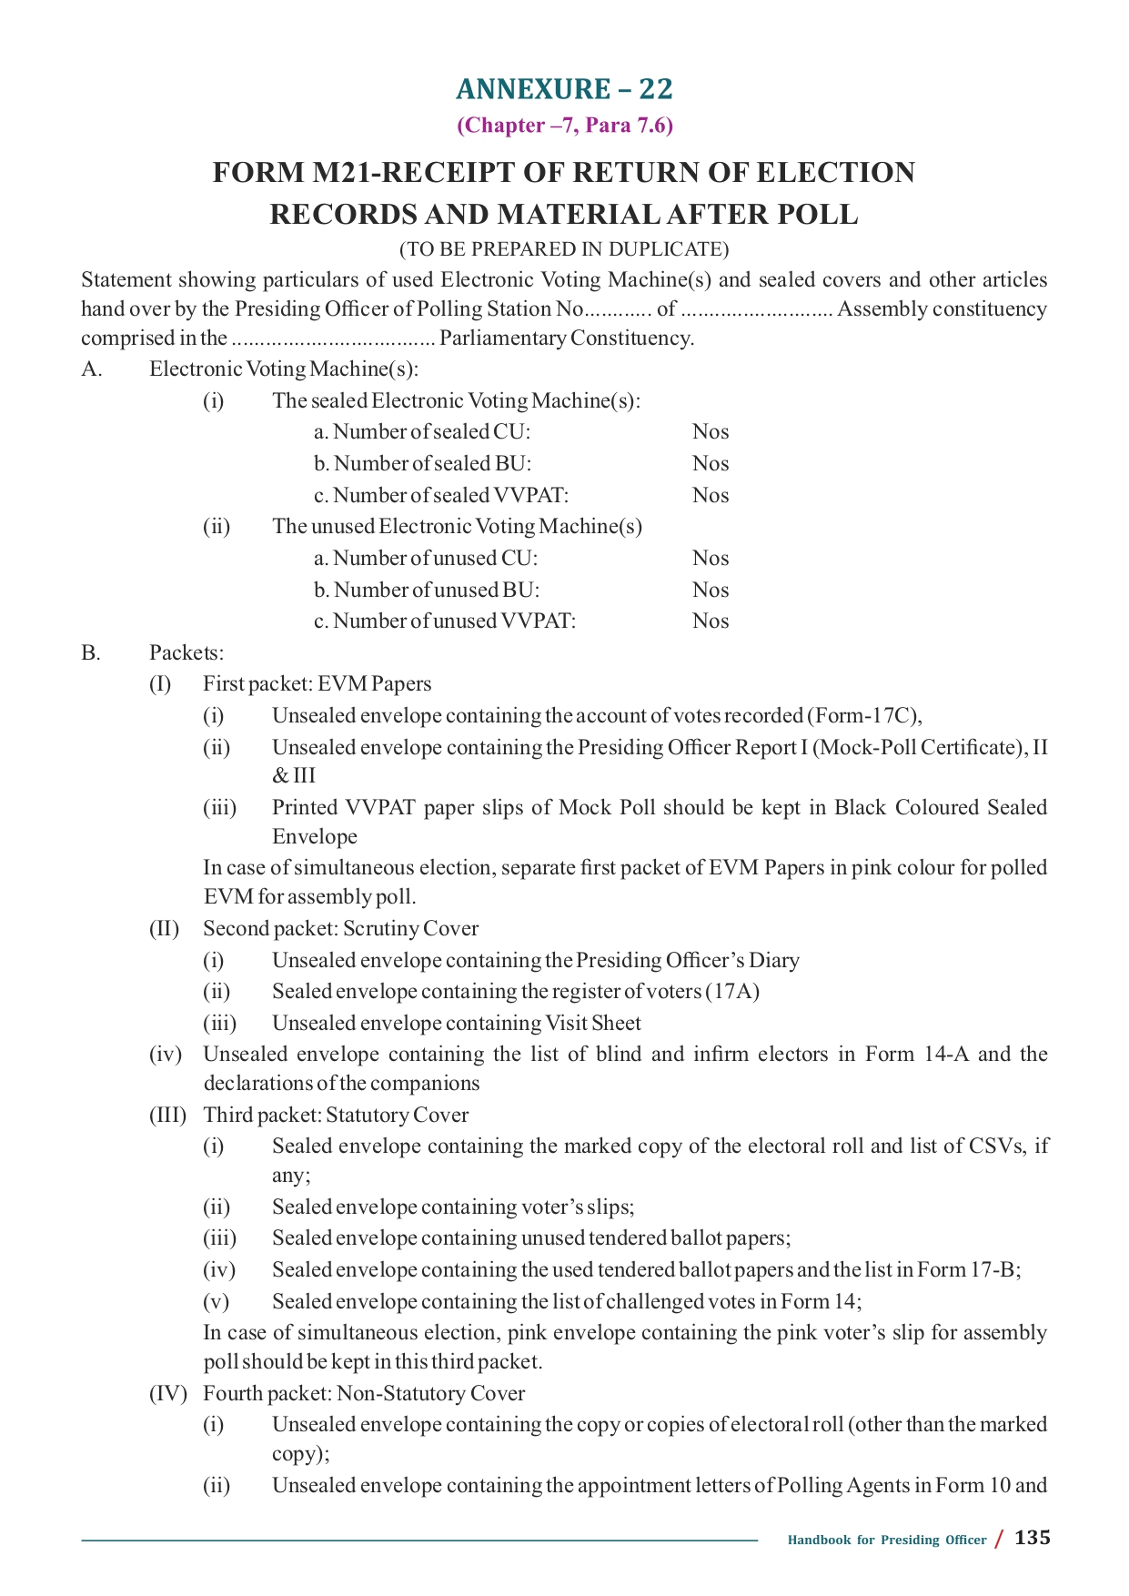

Slide 68
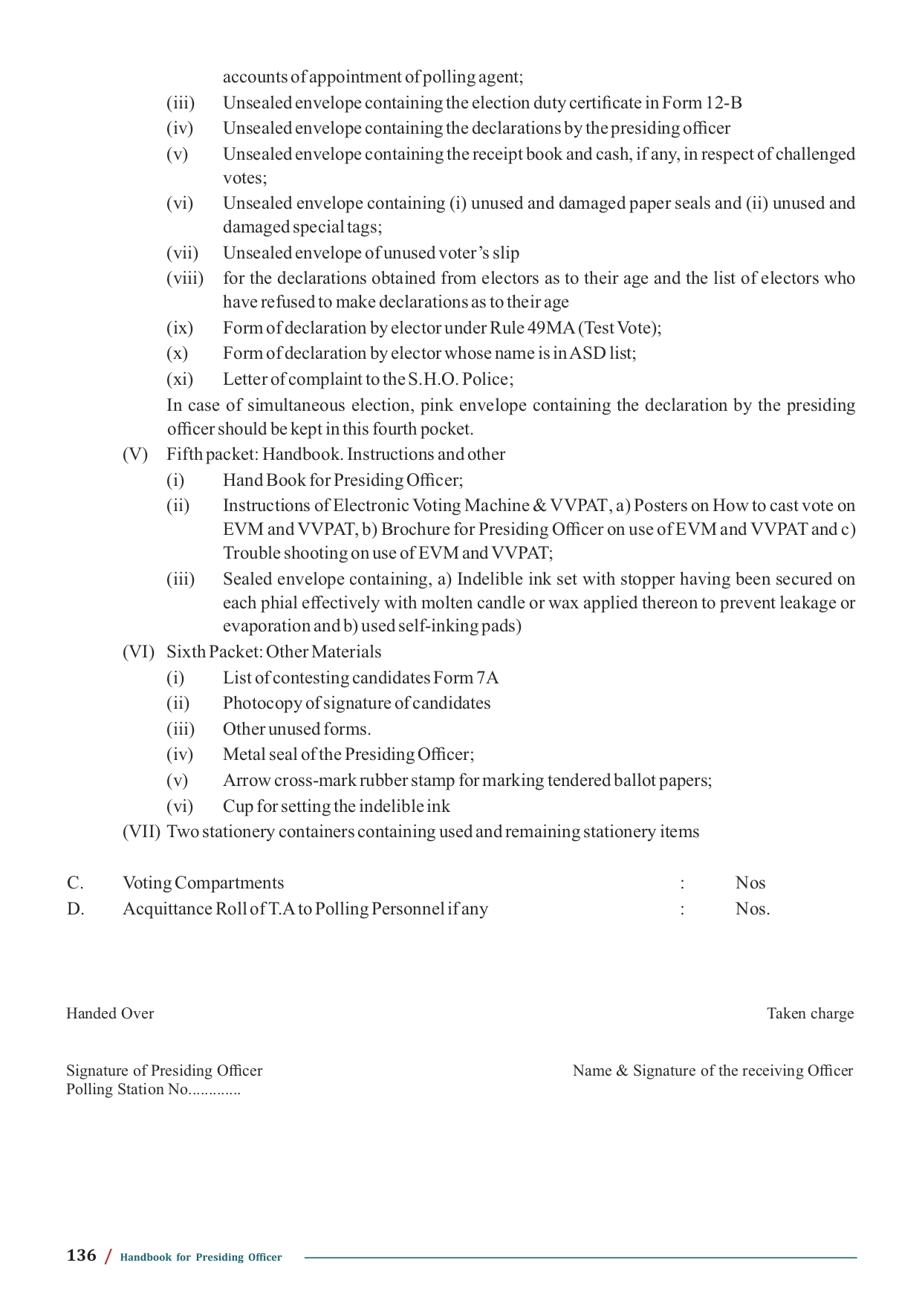

Slide 69
Strong room
Sealing of strong room:
In case General Observer is assigned more than one AC/AS and strong room locations are distributed in the district, senior most General Observer, in consultations with the DEO/RO in advance, will decide which Observer will remain present at the time of closure of which strong room.
Senior most General Observer may also nominate Expenditure Observer to represent any General Observer for sealing of strong room in case of exigencies.
In exceptional cases, senior micro observers may be selected from the list of micro observers deployed for poll day duty can also be authorized by the senior most General Observer to represent any General Observer for sealing of strong room.

Slide 70
Category |  | Types of EVM/VVPATs |  | Designated Strong Room
Category | A | PolledEVMs&VVPATs |  | Polled EVM Strong Room:(for storage of category A&B)
Category | B | Non-functional EVMs VVPATs | Polled
Category | C | Non-functional Un-polled EVMs & VVPATs (failed during mock poll) |  | Repair Strong Room: (for storage of category C), not in the vicinity of polled EVM strong room
Category | D | Unused Reserve EVMs & VVPATs |  | Reserve Strong Room: (for storage of category D), not in the vicinity of polled EVM strong room

Slide 71
(i) One control room adjacent to these strong room locations should be operative round the clock. A Gazetted officer along with a police officer should be put on duty round the clock for monitoring the security arrangements, including CCTV coverage, of strong rooms.
(ii) CCTV cameras with sufficient storage facility shall be installed. CCTV Camera should cover sealed doors of Polled EVM Strong Room and Election Paper Strong Room, security and corridor etc. A proper system to take back up of CCTV footage shall be ensured. Such video data shall be in the custody of the District Election Officer.
(iii) Videography shall be made at the time of the opening and closing of Polled EVM Strong Room and Election Paper Strong Room. Proper log books shall also be maintained.

Slide 72
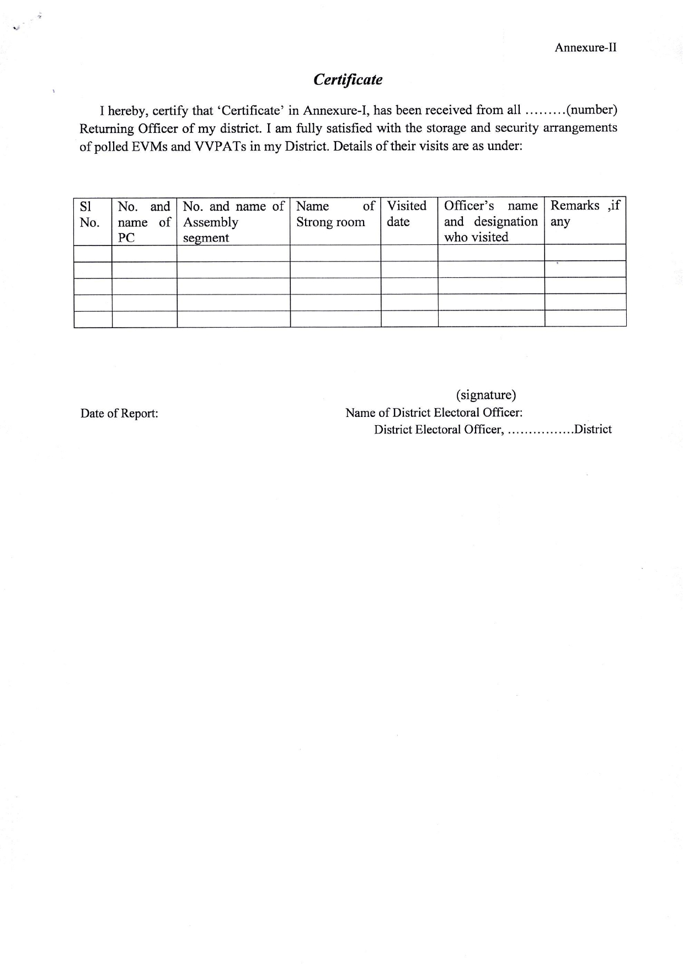
Strongroom inspection
51/8/6/2019-EMPS dated 02.05.2019
RO/ DEO to visit daily morning and evening
If strong room is outside district HQ, DEO to visit atleast once in 3-4 days.
DEO to submit it weekly
Upload the same in CEO portal

Slide 73
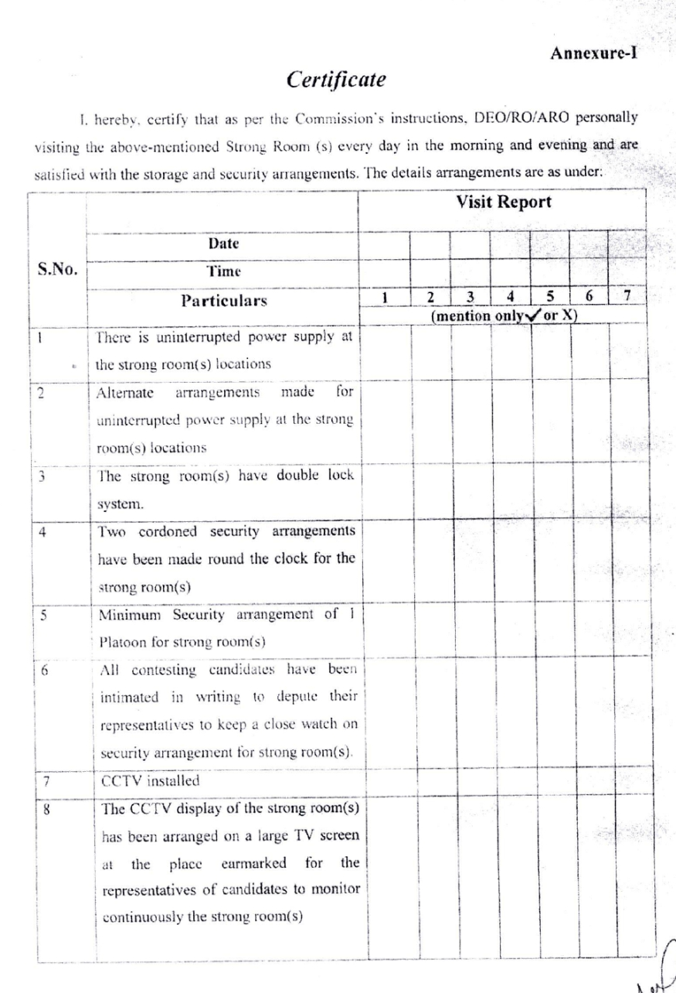
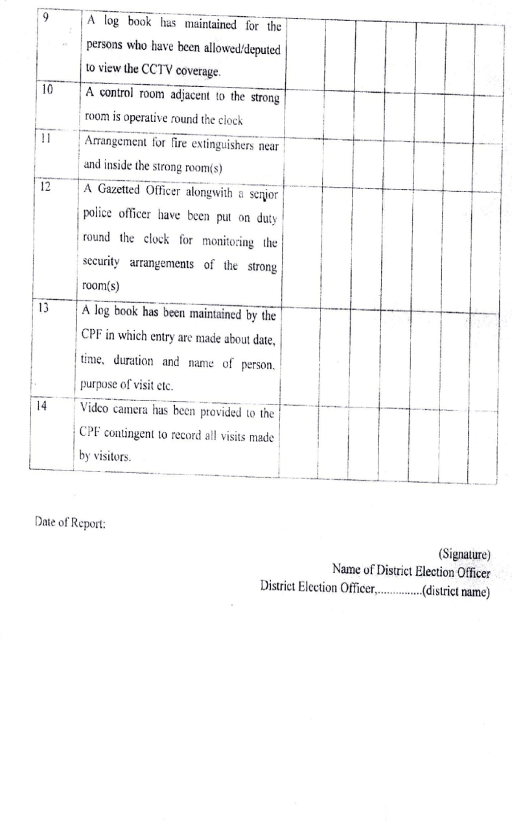
Signed copy to be sent weekly to evmwb2019@gmail.com

Slide 74
Post poll scrutiny
No 464/INST-17 A/2023-EPS Dated: 10th June, 2023 to be followed
Documents to be Scrutinized:
(a)Presiding Officers' diary
(b)Form 17-A (Register of Voters)
(c)Other related documents which include but not restricted to Micro Observers Reports, visitor sheets, reports of zonal magistrates or sector officers, report of Presiding Officer, still photography, videography recordings, CCTV and Webcasting footages
(d)If the number of blind/infirm voters voting at a Polling Station (Rule 40, Conduct of Election Rules 1961) is more than 1% of the total no. of electors in that polling station, scrutiny of Form 14A (list of blind/ infirm voters).
Returning Officer shall collect the information for each Polling Station in prescribed scrutiny format
In case strong room locations are distributed in theconstituency, Observers shall decide, in advance in consultation with the Returning Officer(s) or District Election Officer, to ensure presence of one of the Observers at the time of opening and closing of strong room(s). The information should also be made available to the contesting candidates or their election agents in advance.

Slide 75
Scrutiny to be taken up preferably at 11:00 A.M. on the day following the day of poll
Criteria for selection of Polling Stations for scrutiny:
any complaint of poll rigging, malpractices etc. was received
any significant event (EVM/VVPAT related or otherwise) was reported
poll took place in the absence of any polling agent or in the presence of the agent of only one candidate.
the number of electors who cast their votes using documents other than EPIC (i.e., alternative documents specified by the Commission) exceeded 25% of the total votes cast in that polling station.
more than 10% of such electors who had been identified as ASD turned up and voted.
polling percentage is plus 15% or minus 15% than the average polling percentage of that AC.
there are at least 5 (five) tendered votes and challenged votes reported.
10% or more remarks column of Register of Voters (Form-17A) are blank and does not indicate use of the EPIC/alternate document.
Micro Observer has submitted an adverse report.
Form 17-A and other documents are required to be transported, they shall be transported under proper police escort along with Executive Magistrate. Candidates and their representatives shall be allowed to follow.
where strong rooms are at the place different from the RO headquarters, are brought by the ARO to RO headquarters in time for the scrutiny to be undertaken.

Slide 76
After scrutiny, the Forms 17A and marked copies of electoral roll for each polling station, other documents and material shall be re-sealed with the seal of the Returning Officer.
These sealed envelopes shall then be kept back in the strong room from which they were taken out.
Returning Officer and Observer shall make necessary recommendations as per Annexure-II, to the Commission for repoll, if warranted and wherever considered necessary, giving reasons polling station wise.

Slide 77
Annexure-II
Recommendation of Retuning Officer for Re-poll after scrutiny of Form 17A and other documents
No. and Name of the Assembly Constituency | Recommendation of RO for Re-poll(Yes / No) | In case of recommendation for Re-poll |  | Reasons for Re- poll
 |  | Polling Station Number | Name of Polling Station
Returning Officer
Constituency Name/ Number
Recommendation of Observer

Slide 78
Are you ready?
1. What to check while you are receiving 17C?
2. Are data of test vote availabile in scrutiniy sheet?
3. What are the documents to be kept with EVM in strong room?
4.How report of Micro observer will be collected?
5.What are the documents to be kept in scrutiny cover by Pr.O?
6. Which packet out of 6 packets prescribed by ECI is expected to be the bulkiest?

Slide 79
7.If some polling personnel report that distingushing marks of their booth are not working, what will you do?
8.If any Party checks CU and reports CLOCK ERROR, what will you do?
9.If some parties ask for supplement 1, 2 and 3 for Electoral Roll, how would you guide them?
10.What is the change use of Pink Paper Seal for VVPAT slips?

Slide 80
D.C Decoding list Mobile no. registration Material collection &
Checking of EVMs & Statutory and non-Statutory items
Contact your Sector Officer & move to vehicle Cell
Go to the assigned Polling Station & Check PS number & BLO details
Send Safe Arrival Report (S.M.S: WB<>EL<>SAP)
Find the periphery of 100 meters around the Polling
Station for any campaign posters of political party and candidates.
Polling booth arrangement plan ( Signage )
Prepare and check different forms, write Booth no. & name on forms
&
Marked distinguish seal on forms and prepare of Voting Compartment as per ECI Guideline.
Brief Guidance for Polling personnel: P-1 day

Slide 81
Hang of Important Documents before Starting of Mock Poll ( PS area / Form 7A, EVM awareness poster / important Contact No. / Working Copy)
Polling Agent: Check and verify Appointment Letter
Start Mock Poll and prepare of Mock Poll certificate ,
Send Mock poll completed SMS: WB<>EL<>MP<>04 (No. of Polling Agents)
Sealing after Mock Poll & Start Actual Poll (SMS: WB<>EL<>PS)
After casting of last voter’s vote, close the CUs and sealing of CU & BU, Remove the battery of VVPAT in front of the Polling Agent and seal carrying case of VVPAT with address tag, take signature of Polling Agent
Prepare of statutory Forms and
Take necessary signature of Polling Agent on forms (SMS: WB<>EL<>VT<>Total no. of vote polled)
R.C (SMS: WB<>EL<>SARC)
Submit Polled EVMs (Type A+ Type B (if Any))
and
6 Packet( Statutory and Non Statutory)
Flow Chart for Poll Day

Slide 82



Thank You

